Slide 1
Presentation Title
Subtitle and additional information

Slide 2
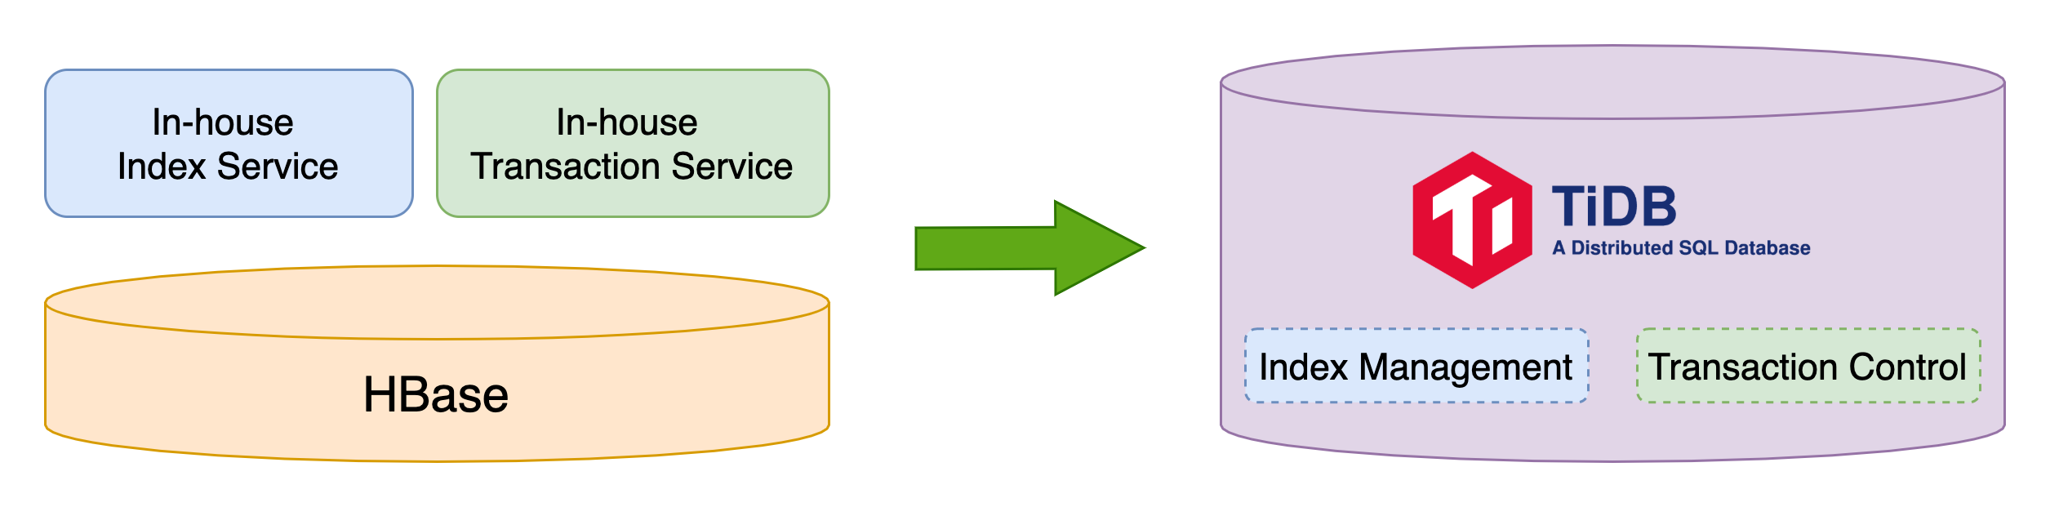
Slide Title
Bullet l1
  Bullet l2
    Bullet l3
      Bullet l4
        Bullet l5

Slide 3
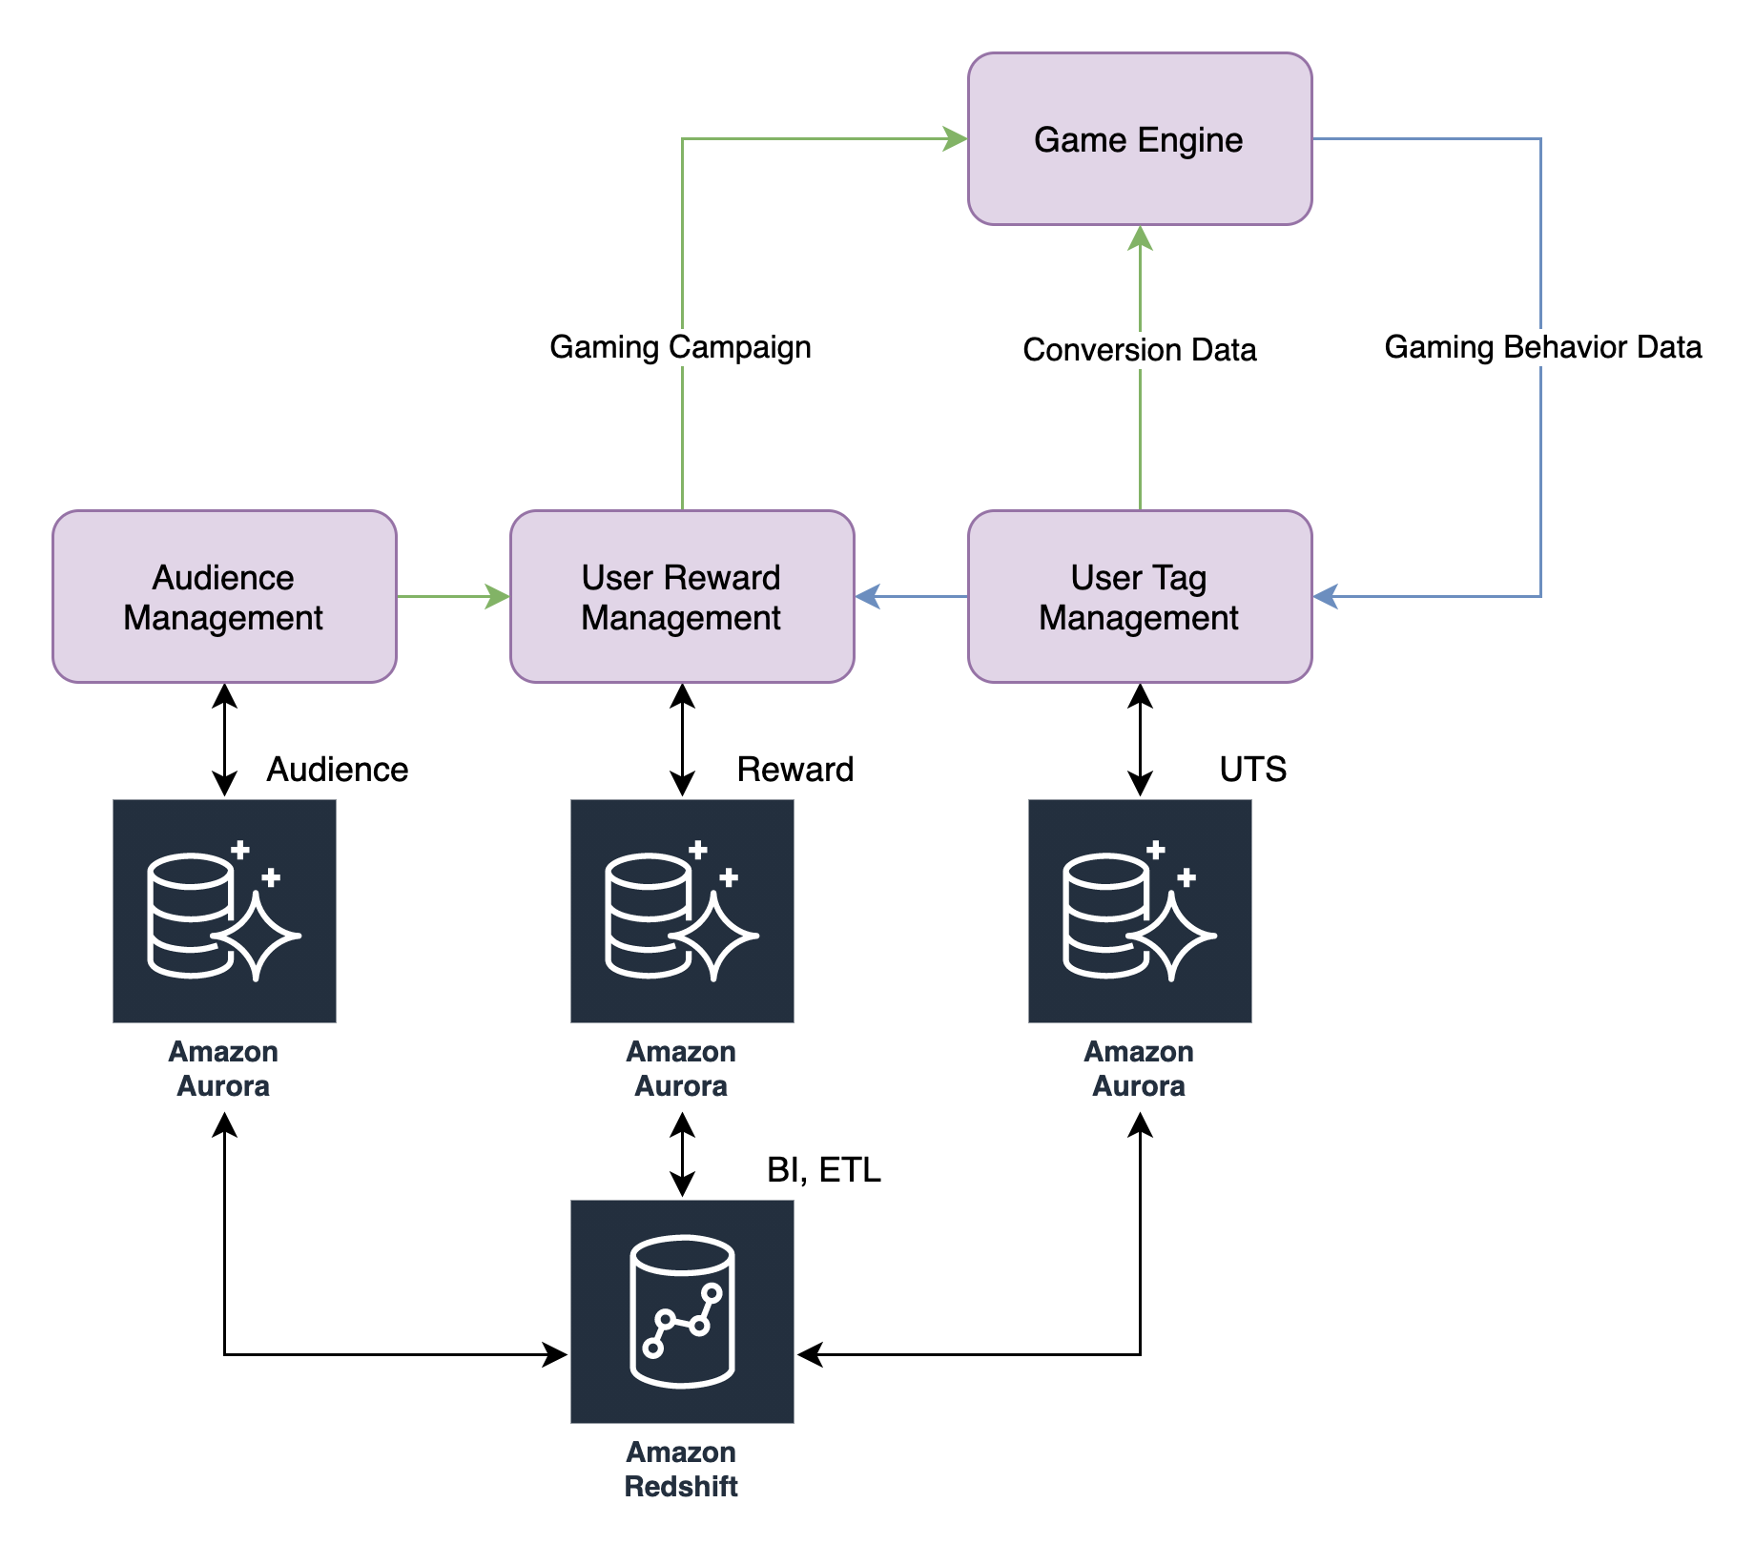
Slide Title
Bullet l1 and this bullet line stops here

Slide 4
Slide Title, Bullet and Code Area
Bullet l1
Bullet l1
  Bullet l2
tidb> SELECT COUNT(*) FROM universe.planets
-> WHERE category_id = 1;
tidb> EXPLAIN SELECT COUNT(*) FROM universe.planets WHERE category_id = 1;
+------------------------------+-----------+-----------+---------------+-------------------------------------+
| id | estRows | task | access object | operator info |
+------------------------------+-----------+-----------+---------------+-------------------------------------+
| StreamAgg_20 | 1.00 | root | | funcs:count(Column#27)->Column#25 |
| └─TableReader_21 | 1.00 | root | | data:StreamAgg_9 |
| └─StreamAgg_9 | 1.00 | cop[tikv] | | funcs:count(1)->Column#27 |
| └─Selection_19 | 163.84 | cop[tikv] | | eq(universe.planets.category_id, 1) |
| └─TableFullScan_18 | 163840.00 | cop[tikv] | table:planets | keep order:false, stats:pseudo |
+------------------------------+-----------+-----------+---------------+-------------------------------------+
5 rows in set (0.00 sec)

Slide 5
Thank You

Slide 6
Section A

Slide 7
Section B

Slide 8
Section C

