Slide 1
TiDB Server Key Performance Parameter And Optimization

Slide 2
Chapter Goals
Understand the configuration of important operating system parameter
Understand the settings of important database configuration parameter
Understand the settings of important database system variables
Notes:
Understand the configuration of important operating system parameter
Understand the settings of important database configuration parameter
Understand the settings of important database system variables

Slide 3
01 Operating System Parameter
Notes:
OS parameter
Before any database is deployed, the setting of system parameter plays a very important role. It can be divided into the following aspects:
- CPU
- Memory
- Disk

Slide 4
CPU (A)
Dynamic frequency scaling
  Definition: CPU dynamic energy saving technology is used to reduce server power consumption. By selecting power management policies with different system idle states, server power consumption can be reduced to varying degrees. Lower power policies mean slower CPU wake-up has a greater impact on performance.
  5 modes
    performance
    userspace
    powersave
    ondemand
    conservative
  Configuration commands:
cpupower frequency-set --governor performancecpupower frequency-set --governor performance
Notes:
CPU (one)
- Frequency Scaling
- cpufreq is a module that dynamically adjusts the CPU frequency and can support five modes
- Definition: CPU dynamic energy saving technology is used to reduce server power consumption. By selecting power management policies with different system idle states, server power consumption can be reduced to varying degrees. Lower power policies mean slower CPU wake-up has a greater impact on performance. For applications with high latency and performance requirements, it is recommended to turn off dynamic CPU throttling, disable CPU hibernation, and fix the CPU frequency to the highest.
- 5 modes:
1. Performance: As the name implies, it focuses only on efficiency, fixing the CPU frequency at the highest operating frequency it supports, rather than dynamically adjusting it.
2. Userspace: The earliest cpufreq subsystem provided this flexibility to users through the userspace governor. The user state application is given the decision of the frequency conversion policy, and an interface is provided for the user state application to adjust the CPU frequency. This is the model that has been used for a long time. This can be configured by manually editing the configuration file.
3. powersave: Set the CPU frequency to the lowest so-called “power saving” mode, where the CPU works at the lowest operating frequency it supports. As a result, both governors are static governors, meaning that when they are used, the CPU frequency does not dynamically adjust to changes in system runtime load. These two governors correspond to two extreme application scenarios, where using a performance governor is the greatest pursuit of system performance, while using a powersave governor is the greatest pursuit of low system power consumption.
4. ondemand: Quickly and dynamically adjust the CPU frequency as needed. As soon as there is a CPU calculation, the task will immediately reach the maximum frequency, and return to the lowest frequency immediately after execution; ondemand: userspace is the detection of the kernel state, the user state is adjusted, and the efficiency is inefficient. And ondemand is the kind of governor that people have long wanted to see working entirely in the kernel state and able to sample and analyze the system load at more fine-grained intervals. When the ondemand governor detects that the system load exceeds the percentage set by the up_threshold, the user currently needs the CPU to provide more processing power, so the ondemand governor sets the CPU to run at the highest frequency. But when the ondemand governor detects a drop in system load and can reduce the CPU frequency, what frequency should it be reduced to? The initial implementation of the ondemand governor is to tune down to the next available frequency within an optional frequency range; for example, the CPU supports three selectable frequencies, 1.67GHz, 1.33GHz, and 1GHz, which the ondemand governor finds can be lowered if the CPU is running at 1.67GHz Operating frequency, then 1.33GHz will be selected as the target frequency for downscaling.
5. Frequency: Unlike ondemand, the CPU frequency is adjusted smoothly, the frequency rise and fall is gradual, and automatically adjusts at the upper and lower frequency limits. The difference between ondemand and ondemand is that it allocates frequencies on demand instead of simply pursuing the highest frequency.
- Performance mode should be selected to ensure service performance, and the CPU frequency is fixed to the highest operating frequency it supports
- Set command cpupower frequency-set —governor performancecpupower frequency-set —governor performance

Slide 5
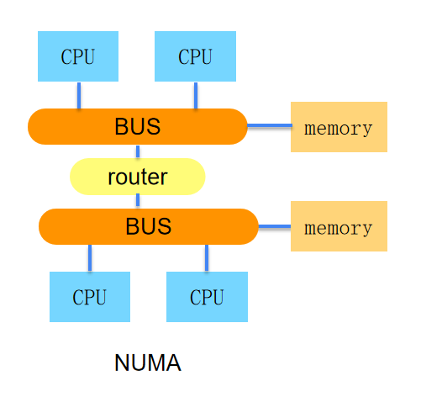
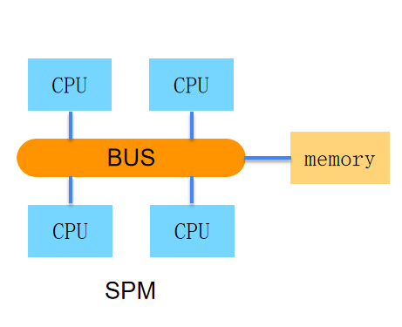
CPU (B)
Numa Binding
  Definition: Memory is directly bound to the CPU , and the response time is short CPU only when accessing the physical address of the memory managed by itself.
  Server with NUMA architecture, by binding NUMA node, avoids NUMA cross-accessing memory as much as possible, and improves tidb-server performance.
  Can be numactl bound using the command
Notes:
- Numa Binding
- Features of NUMA: Memory is directly bound to the CPU, and the CPU will only have a short response time if it accesses the physical address of the memory managed by itself; while accessing data on memory addresses managed by other CPUs, it needs to be accessed through the InterConnect channel, and the response time will increase.
- Servers with NUMA architecture, improve the performance of tidb-server by binding NUMA node to avoid accessing memory across NUMA as much as possible
- You can use the numactl command to bind, please refer to the man query for details

Slide 6
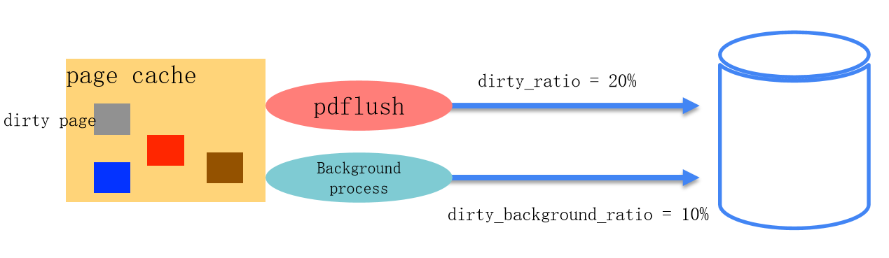
Memory
Transparent Huge Page (THP)
  Not recommended THP for database applications because databases tend to have sparse rather than contiguous memory access patterns, and allocations when high-level memory fragmentation is severe THP The page will experience significant delays. If you turn on THP the direct memory trimming function for, there will also be a CPU surge in system usage, so it is recommended to turn it off THP .
Virtual Memory Parameters
  dirty_ratio、dirty_background_ratio : Normally no adjustment is required. For high performance SSD , such as NVMe devices, lowering its value can improve the efficiency of memory reclamation
Notes:
- Transparent Huge Page (THP)
- Definitions
There are two types of large pages in Linux: huge pages (standard large pages) and transparent huge pages (transparent large pages).
Memory is managed in blocks as pages, and the default page size for most systems today is 4096 bytes or 4K. 1MB of memory equals 256 pages; 1GB of memory equals 256000 pages.
The CPU has a built-in memory snap-in that contains a list of these pages, each referenced by a page table entry. As memory gets larger, the more expensive the CPU needs to manage these memory pages, which can have an impact on the performance of the operating system.
1. Huge pages
Huge pages were introduced after Linux Kernel 2.6 to allow the operating system to support the large page capacity features of modern hardware architectures by replacing traditional 4kb memory pages by using large pages of memory to accommodate the increasing amount of system memory.
Huge pages are available in two format sizes: 2MB and 1GB, with a 2MB page size suitable for GB-sized memory, and a 1GB page size suitable for terabyte-level memory; 2MB is the default page size.
2. Huge Transparent Pages
Transparent Huge Pages, short for THP, is a feature introduced in RHEL 6. Transparent pages are enabled by default on Linux6.
Because huge pages are difficult to manage manually and often require significant code changes to be effective, RHEL 6 began introducing Transparent Huge Pages (THP), an abstraction layer that automates the creation, management, and use of traditional large pages.
THP reduces the complexity of using traditional large pages for system administrators and developers because the goal of THP is to improve performance, so other developers (from the community and Red Hat) have test and optimized THP across a variety of systems, configurations, applications, and workloads. This allows the default settings of THP to improve the performance of most system configurations. However, using THP for database workloads is not recommended.
The biggest difference between the two is that standard large page management is pre-allocated, while Transparent Huge Pages management is dynamic.
- THP is not recommended for database applications because databases tend to have sparse rather than contiguous memory access patterns, and high latency in allocating THP pages when high-level memory fragmentation is severe. Turning on the direct memory throttling for THP can also cause a surge in system CPU usage, so it is recommended to turn off THP.
- Virtual Memory Parameters
- dirty_ratio percentage value. When the total number of dirty page caches reaches this percentage of the total system memory, the system begins writing the dirty page cache to disk using the pdflush operation. The default value is 20%, which usually does not need to be adjusted. For high-performance SSDs, such as NVMe devices, lowering their value can improve the efficiency of memory reclamation.
- dirty_background_ratio percentage value. When the total number of dirty page caches reaches this percentage of the total system memory, the system starts writing dirty page caches to disk in the background. The default value is 10% and usually does not need to be adjusted. For high-performance SSDs, such as NVMe devices, setting a lower value can improve the efficiency of memory reclamation.

Slide 7
Disk
I/O scheduler
  I/O schedule scheduler determines I/O when and for how long an operation runs on a storage device, also known as I/O lifts.
  1.NOOP
  2.CFQ
  3.DEADLINE
Mount Parameters
  By default, linux the time of file access atime is recorded, and the file system is accessed, created, update, etc. Some timestamp of the file are recorded, such as when the file was created, when it was last update, and when it was last accessed; this is unnecessary in most cases.
  You can try using noatime and nodiratime disabling logging the timestamp of the most recent visit.
Notes:
disk
- I/O scheduler
- Definitions:
The Linux kernel I/O schedule's job is to pass data to the underlying storage device in a reasonable and optimized manner. Depending on the policies of the I/O scheduler, the performance of a TiDB DB instance may vary. Of course, if your system is under low load, the I/O scheduler won't make much of a difference.
However, if you are facing I/O limitation and your system must handle heavy loads, choosing the right I/O scheduler may be critical.
In general, Linux supports the following I/O schedulers:
NOOP:
NOOP is the simplest of all I/O schedulers. It simply sends data to a FIFO queue, merges request to save on disk to find and pass the data.
CFQ:
CFQ is short for “Totally Fair schedule.” The idea of CFQ is to give all processes that belong to the same priority a time slice of the same size. Processes that perform sequential I/O may receive more bandwidth than processes that perform random I/O (random I/O often occurs during OLTP workloads in a database).
CFQ is the default and is usually preferred for desktop applications, and should remain responsive. This is not necessarily the optimal configuration for a database server.
Deadline:
The DEADMAL scheduler tries to ensure that no process will go hungry. The kernel imposes a deadline (deadline) for each I/O. Actual test have shown that using a deadline is actually always faster than relying on the default value (= CFQ). However, in many cases, they make no difference.
- The I/O schedule determines when and for how long an I/O operation will run on a storage device, also known as an I/O lift
- Set to noop for SSD devices
- Mount Parameters
- By default, Linux records the time of file access, atime. The file system records some timestamp of files when files are accessed, created, update, etc., such as: file creation time, last update time, and last access time; this is unnecessary in most cases.
Because a large number of files are accessed while the system is running, reducing some actions (such as reducing the number of timestamp records, etc.) will significantly improve the efficiency of disk IO and improve the performance of the file system.
If you are experiencing high machine IO load or high CPU WAIT, you can try using noatime and nodiratime to disallow logging the timestamp of the most recent access.
- Noatime will disable updates to metadata when reading files
- Nodiratime disables metadata updates when reading directories

Slide 8
02 TiDB Configuration
Notes:
TiDB Configuration
Before a database is deployed, the setting of database configuration parameter plays a very important role. It can be divided into the following aspects:
- Performance
- TiKV Client
- Prepared Plan Cache

Slide 9
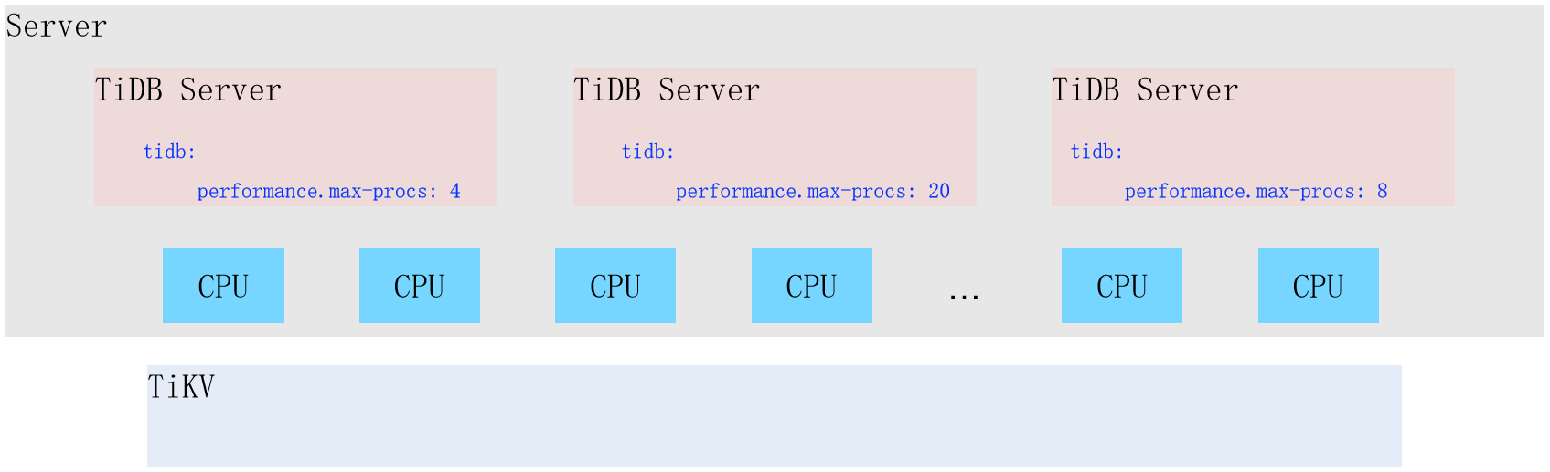
Performance (A)
max-proc
  Control tidb-server the CPU number of cores used and deploy multiple on a single machine tidb-server Setting this variable limitation the tidb-server resources used to avoid affecting other processes.
Notes:
Performance
- max-proc
- Control the number of CPU cores used by tidb-server. Deploying multiple tidb-servers on a single machine Set this variable to limitation the resources used by tidb-server to avoid affecting other processes
- It is recommended to deploy n TiDB (n = the number of NUMA CPUs) on the NUMA schema server, and set the value of the max-procs variable of TiDB to the same number of cores as the NUMA CPU.
- This parameter controls the number of CPU cores that can be used by the entire Go process. By default, the number of CPUs of the current machine or cgroups. The Go runtime regularly uses a percentage of thread for background work such as GC. In hybrid deployment mode, if you do not limitation this parameter, background operations such as GC can consume too much CPU resources.
- token-limit
- Configure the number of sessions that can execute request at the same time for traffic flow control to avoid tidb-server resource exhaustion due to excessive number of concurrent request, and service failure to respond
- Default: 1000
- If there are more connections currently running than the token-limit, the request will block, waiting for the completed operation to release the token
If you increase the token-limit to 3000, then the number of connections running at the same time will be 3000, so the impact to consider is whether many of these sessions will put a lot of pressure on tidb-server and tikv-server.
You can view the current monitoring system resources, over-view, if the peak business period, the system resource consumption is very low, then there should be no problem to increase the token-limit, if the peak time period, the system load is already high, and the service latency is also relatively high, then it is recommended to try not to adjust, or you can try to lower it first.
- force-priority
- Control the priority of the tidb-server. Once set, all request will be executed using that priority. A common scenario is to configure a separate tidb-server to set a low priority and execute AP request.
Default: NO_PRIORITY
The statement priorities supported by TiDB include NO_PRIORITY, LOW_PRIORITY, DELAYED, and HIGH_PRIORITY.
scenario 1: If you need to specify a dedicated server pool for OLAP query, you can set this value to LOW_PRIORITY to ensure that the TiKV server prioritizes OLTP request received by other TiDB server pools. This allows OLTP performance to be more stable, but OLAP performance may decrease slightly.
scenario 2: TiDB automatically sets the table scan to LOW_PRIORITY. By setting the DML modifier to HIGH PRIORITY or LOW PRIORITY, you can override the priority of a statement.
scenario 3: Database low-speed export configuration —params “tidb-force-priority=low_priority, tidb_distsql_scan_concurrency=5" can lower the execution priority of export statement and reduce the concurrency of scan data during TiDB export, so as to implementation Slow-speed backup data with low database impact.
- committer-concurrency
- Controls the maximum number of concurrency for the commit phase of a transaction. For a large transaction, committing a transaction requires sending a large number of write request to TiKV. Setting up a larger concurrency may allow large transaction to be committed faster, but it can also cause the TiKV to become overwhelmed by instantaneous stress, and request pile up and become unresponsive.

Slide 10
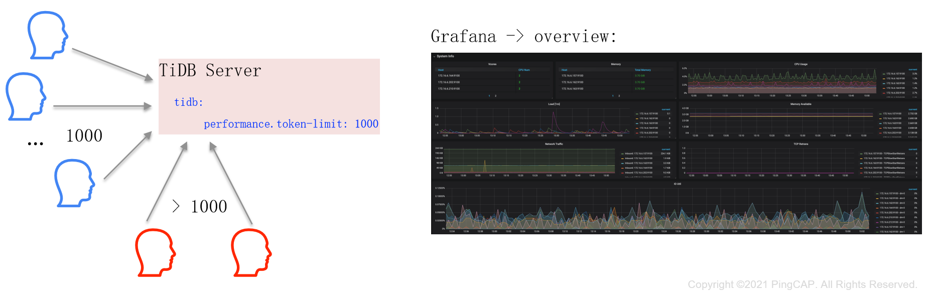
Performance (B)
token-limit
  Configure the session number of request that can be executed concurrently for traffic flow control to avoid tidb-server resource exhaustion due to excessive number of concurrent request , the service is unresponsive.
Notes:
Performance
- max-proc
- Control the number of CPU cores used by tidb-server. Deploying multiple tidb-servers on a single machine Set this variable to limitation the resources used by tidb-server to avoid affecting other processes
- It is recommended to deploy n TiDB (n = the number of NUMA CPUs) on the NUMA schema server, and set the value of the max-procs variable of TiDB to the same number of cores as the NUMA CPU.
- This parameter controls the number of CPU cores that can be used by the entire Go process. By default, the number of CPUs of the current machine or cgroups. The Go runtime regularly uses a percentage of thread for background work such as GC. In hybrid deployment mode, if you do not limitation this parameter, background operations such as GC can consume too much CPU resources.
- token-limit
- Configure the number of sessions that can execute request at the same time for traffic flow control to avoid tidb-server resource exhaustion due to excessive number of concurrent request, and service failure to respond
- Default: 1000
- If there are more connections currently running than the token-limit, the request will block, waiting for the completed operation to release the token
If you increase the token-limit to 3000, then the number of connections running at the same time will be 3000, so the impact to consider is whether many of these sessions will put a lot of pressure on tidb-server and tikv-server.
You can view the current monitoring system resources, over-view, if the peak business period, the system resource consumption is very low, then there should be no problem to increase the token-limit, if the peak time period, the system load is already high, and the service latency is also relatively high, then it is recommended to try not to adjust, or you can try to lower it first.
- force-priority
- Control the priority of the tidb-server. Once set, all request will be executed using that priority. A common scenario is to configure a separate tidb-server to set a low priority and execute AP request.
Default: NO_PRIORITY
The statement priorities supported by TiDB include NO_PRIORITY, LOW_PRIORITY, DELAYED, and HIGH_PRIORITY.
scenario 1: If you need to specify a dedicated server pool for OLAP query, you can set this value to LOW_PRIORITY to ensure that the TiKV server prioritizes OLTP request received by other TiDB server pools. This allows OLTP performance to be more stable, but OLAP performance may decrease slightly.
scenario 2: TiDB automatically sets the table scan to LOW_PRIORITY. By setting the DML modifier to HIGH PRIORITY or LOW PRIORITY, you can override the priority of a statement.
scenario 3: Database low-speed export configuration —params “tidb-force-priority=low_priority, tidb_distsql_scan_concurrency=5" can lower the execution priority of export statement and reduce the concurrency of scan data during TiDB export, so as to implementation Slow-speed backup data with low database impact.
- committer-concurrency
- Controls the maximum number of concurrency for the commit phase of a transaction. For a large transaction, committing a transaction requires sending a large number of write request to TiKV. Setting up a larger concurrency may allow large transaction to be committed faster, but it can also cause the TiKV to become overwhelmed by instantaneous stress, and request pile up and become unresponsive.

Slide 11
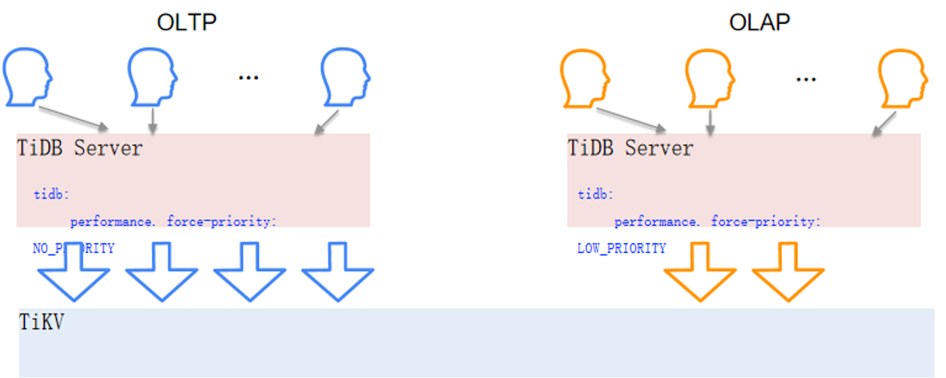
Performance (C)
force-priority
  control tidb-server priority, which, when set, will be used by all request to be executed.
Notes:
Performance
- max-proc
- Control the number of CPU cores used by tidb-server. Deploying multiple tidb-servers on a single machine Set this variable to limitation the resources used by tidb-server to avoid affecting other processes
- It is recommended to deploy n TiDB (n = the number of NUMA CPUs) on the NUMA schema server, and set the value of the max-procs variable of TiDB to the same number of cores as the NUMA CPU.
- This parameter controls the number of CPU cores that can be used by the entire Go process. By default, the number of CPUs of the current machine or cgroups. The Go runtime regularly uses a percentage of thread for background work such as GC. In hybrid deployment mode, if you do not limitation this parameter, background operations such as GC can consume too much CPU resources.
- token-limit
- Configure the number of sessions that can execute request at the same time for traffic flow control to avoid tidb-server resource exhaustion due to excessive number of concurrent request, and service failure to respond
- Default: 1000
- If there are more connections currently running than the token-limit, the request will block, waiting for the completed operation to release the token
If you increase the token-limit to 3000, then the number of connections running at the same time will be 3000, so the impact to consider is whether many of these sessions will put a lot of pressure on tidb-server and tikv-server.
You can view the current monitoring system resources, over-view, if the peak business period, the system resource consumption is very low, then there should be no problem to increase the token-limit, if the peak time period, the system load is already high, and the service latency is also relatively high, then it is recommended to try not to adjust, or you can try to lower it first.
- force-priority
- Control the priority of the tidb-server. Once set, all request will be executed using that priority. A common scenario is to configure a separate tidb-server to set a low priority and execute AP request.
Default: NO_PRIORITY
The statement priorities supported by TiDB include NO_PRIORITY, LOW_PRIORITY, DELAYED, and HIGH_PRIORITY.
scenario 1: If you need to specify a dedicated server pool for OLAP query, you can set this value to LOW_PRIORITY to ensure that the TiKV server prioritizes OLTP request received by other TiDB server pools. This allows OLTP performance to be more stable, but OLAP performance may decrease slightly.
scenario 2: TiDB automatically sets the table scan to LOW_PRIORITY. By setting the DML modifier to HIGH PRIORITY or LOW PRIORITY, you can override the priority of a statement.
scenario 3: Database low-speed export configuration —params “tidb-force-priority=low_priority, tidb_distsql_scan_concurrency=5" can lower the execution priority of export statement and reduce the concurrency of scan data during TiDB export, so as to implementation Slow-speed backup data with low database impact.
- committer-concurrency
- Controls the maximum number of concurrency for the commit phase of a transaction. For a large transaction, committing a transaction requires sending a large number of write request to TiKV. Setting up a larger concurrency may allow large transaction to be committed faster, but it can also cause the TiKV to become overwhelmed by instantaneous stress, and request pile up and become unresponsive.

Slide 12
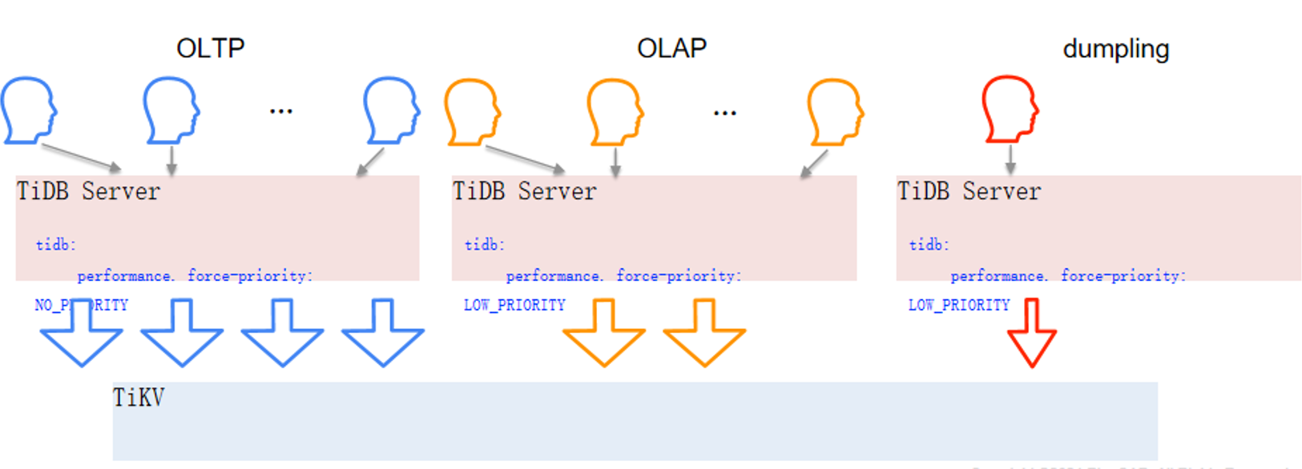
Performance (C)
force-priority
  control tidb-server priority, which, when set, will be used by all request to be executed.
Notes:
Performance
- max-proc
- Control the number of CPU cores used by tidb-server. Deploying multiple tidb-servers on a single machine Set this variable to limitation the resources used by tidb-server to avoid affecting other processes
- It is recommended to deploy n TiDB (n = the number of NUMA CPUs) on the NUMA schema server, and set the value of the max-procs variable of TiDB to the same number of cores as the NUMA CPU.
- This parameter controls the number of CPU cores that can be used by the entire Go process. By default, the number of CPUs of the current machine or cgroups. The Go runtime regularly uses a percentage of thread for background work such as GC. In hybrid deployment mode, if you do not limitation this parameter, background operations such as GC can consume too much CPU resources.
- token-limit
- Configure the number of sessions that can execute request at the same time for traffic flow control to avoid tidb-server resource exhaustion due to excessive number of concurrent request, and service failure to respond
- Default: 1000
- If there are more connections currently running than the token-limit, the request will block, waiting for the completed operation to release the token
If you increase the token-limit to 3000, then the number of connections running at the same time will be 3000, so the impact to consider is whether many of these sessions will put a lot of pressure on tidb-server and tikv-server.
You can view the current monitoring system resources, over-view, if the peak business period, the system resource consumption is very low, then there should be no problem to increase the token-limit, if the peak time period, the system load is already high, and the service latency is also relatively high, then it is recommended to try not to adjust, or you can try to lower it first.
- force-priority
- Control the priority of the tidb-server. Once set, all request will be executed using that priority. A common scenario is to configure a separate tidb-server to set a low priority and execute AP request.
Default: NO_PRIORITY
The statement priorities supported by TiDB include NO_PRIORITY, LOW_PRIORITY, DELAYED, and HIGH_PRIORITY.
scenario 1: If you need to specify a dedicated server pool for OLAP query, you can set this value to LOW_PRIORITY to ensure that the TiKV server prioritizes OLTP request received by other TiDB server pools. This allows OLTP performance to be more stable, but OLAP performance may decrease slightly.
scenario 2: TiDB automatically sets the table scan to LOW_PRIORITY. By setting the DML modifier to HIGH PRIORITY or LOW PRIORITY, you can override the priority of a statement.
scenario 3: Database low-speed export configuration —params “tidb-force-priority=low_priority, tidb_distsql_scan_concurrency=5" can lower the execution priority of export statement and reduce the concurrency of scan data during TiDB export, so as to implementation Slow-speed backup data with low database impact.
- committer-concurrency
- Controls the maximum number of concurrency for the commit phase of a transaction. For a large transaction, committing a transaction requires sending a large number of write request to TiKV. Setting up a larger concurrency may allow large transaction to be committed faster, but it can also cause the TiKV to become overwhelmed by instantaneous stress, and request pile up and become unresponsive.

Slide 13
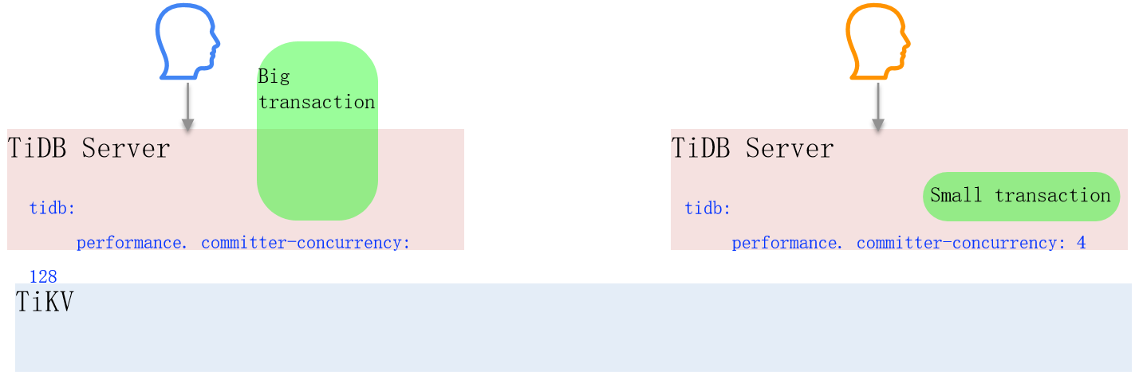
Performance (D)
committer-concurrency
  Controls the commit maximum number of concurrency for a transaction stage. For a large transaction, committing the transaction requires TiKV sending a large number of write request to. Setting a larger concurrency may allow large transaction to be committed faster, but it can also cause TiKV instantaneous stress to request up and become unresponsive.
Notes:
Performance
- max-proc
- Control the number of CPU cores used by tidb-server. Deploying multiple tidb-servers on a single machine Set this variable to limitation the resources used by tidb-server to avoid affecting other processes
- It is recommended to deploy n TiDB (n = the number of NUMA CPUs) on the NUMA schema server, and set the value of the max-procs variable of TiDB to the same number of cores as the NUMA CPU.
- This parameter controls the number of CPU cores that can be used by the entire Go process. By default, the number of CPUs of the current machine or cgroups. The Go runtime regularly uses a percentage of thread for background work such as GC. In hybrid deployment mode, if you do not limitation this parameter, background operations such as GC can consume too much CPU resources.
- token-limit
- Configure the number of sessions that can execute request at the same time for traffic flow control to avoid tidb-server resource exhaustion due to excessive number of concurrent request, and service failure to respond
- Default: 1000
- If there are more connections currently running than the token-limit, the request will block, waiting for the completed operation to release the token
If you increase the token-limit to 3000, then the number of connections running at the same time will be 3000, so the impact to consider is whether many of these sessions will put a lot of pressure on tidb-server and tikv-server.
You can view the current monitoring system resources, over-view, if the peak business period, the system resource consumption is very low, then there should be no problem to increase the token-limit, if the peak time period, the system load is already high, and the service latency is also relatively high, then it is recommended to try not to adjust, or you can try to lower it first.
- force-priority
- Control the priority of the tidb-server. Once set, all request will be executed using that priority. A common scenario is to configure a separate tidb-server to set a low priority and execute AP request.
Default: NO_PRIORITY
The statement priorities supported by TiDB include NO_PRIORITY, LOW_PRIORITY, DELAYED, and HIGH_PRIORITY.
scenario 1: If you need to specify a dedicated server pool for OLAP query, you can set this value to LOW_PRIORITY to ensure that the TiKV server prioritizes OLTP request received by other TiDB server pools. This allows OLTP performance to be more stable, but OLAP performance may decrease slightly.
scenario 2: TiDB automatically sets the table scan to LOW_PRIORITY. By setting the DML modifier to HIGH PRIORITY or LOW PRIORITY, you can override the priority of a statement.
scenario 3: Database low-speed export configuration —params “tidb-force-priority=low_priority, tidb_distsql_scan_concurrency=5" can lower the execution priority of export statement and reduce the concurrency of scan data during TiDB export, so as to implementation Slow-speed backup data with low database impact.
- committer-concurrency
- Controls the maximum number of concurrency for the commit phase of a transaction. For a large transaction, committing a transaction requires sending a large number of write request to TiKV. Setting up a larger concurrency may allow large transaction to be committed faster, but it can also cause the TiKV to become overwhelmed by instantaneous stress, and request pile up and become unresponsive.

Slide 14
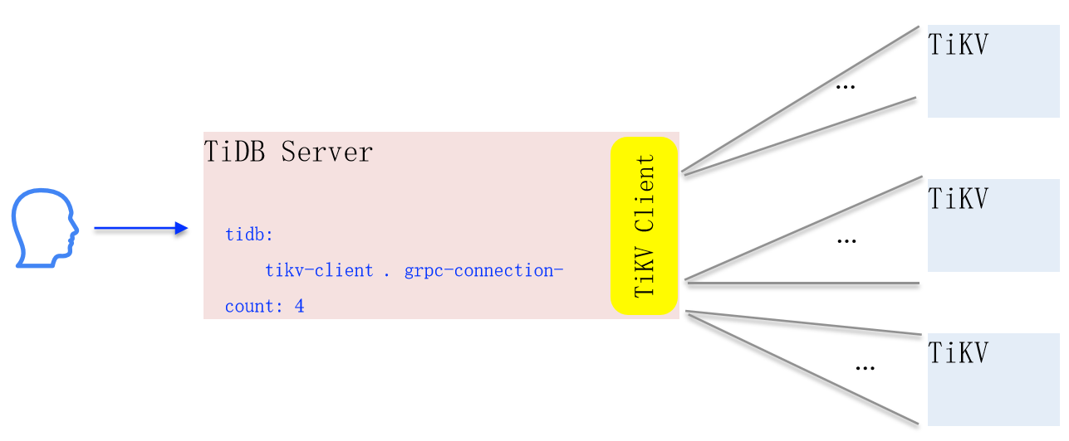
TiKV Client
grpc-connection-count
  TiKV between settings TiDB and each grpc The number of connections, when a large number of concurrent request are sent to one grpc connection, a single gRPC The connection sends row serially, and may become a bottleneck. gPRC When the connection becomes a bottleneck, set a larger gRPC The number of connections can improve performance, but at the cost of consuming more system resources.
Notes:
TiKV client
- grpc-connection-count
- Set the number of grpc connections between TiDB and each TiKV. When a large number of concurrent request are sent to one grpc connection, a single gRPC connection sends request serially, may become a bottleneck. When Gprc connection becomes a bottleneck, setting a larger number of gRPC connections can improve performance, but at the cost of consuming more system resources.

Slide 15
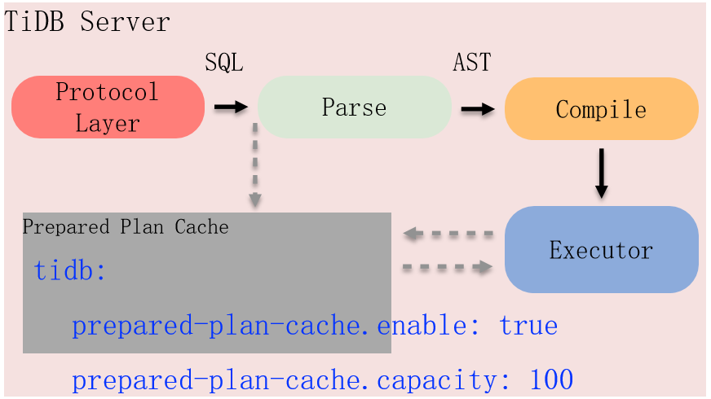
Prepared Plan Cache
enabled : Reduce the computational overhead caused by execution plans, so that statement of the same type use the same execution plan, and improve performance, at the cost of which execution plans may not be optimal when data or query conditions change.
capacity : Used to limitation cache the size (number of cache entries) to avoid using too much memory if the application uses a large number of different type of If the request exceeds capacity the limit, the plan cache effect of will be discounted.
Notes:
Prepared Plan Cache
- enabled/capacity
- Reduce computational overhead caused by execution plans after enabling statement of the same type to use the same execution plan, improving performance at the cost that execution plans may not be the best when data or query conditions change
- Capacity is used to limitation the size of the cache to avoid using too much memory. If the application uses a large number of different types of request and exceeds the capacity limit, the effect of plan cache will be compromised

Slide 16
03 TiDB System Variables
Notes:
TiDB System Variables
After a database is deployed, the setting of database system variables plays a very important role. It can be divided into the following aspects:
- Concurrency
- Batch size
- Limit
- Backoff

Slide 17
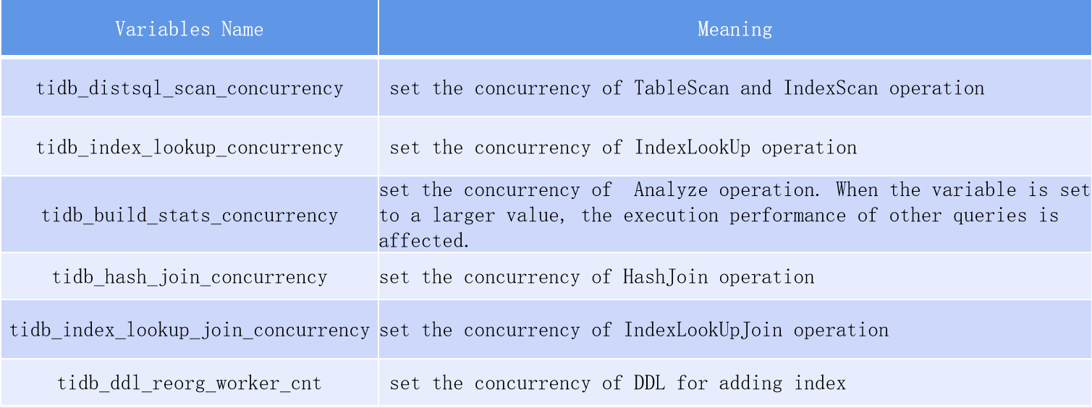
Concurrency
When system resources are idle, setting higher concurrency to make full use of resources can improve overall performance, but higher concurrency often consumes more system resources, which can reduce overall performance when resources are tight
Notes:
Concurrency
- Basic principles
- When system resources are idle, setting higher concurrency allows resources to be fully utilized can improve overall performance. However, higher concurrency often consumes more system resources, and reduces overall performance when resources are tight
- tidb_distsql_scan_concurrency
- Control the concurrency of TableScan and IndexScan operators
- tidb_index_lookup_concurrency
- Control the concurrency of the IndexLookup operator
- tidb_build_stats_concurrency
- Control the concurrency of the Analyze execution, which may affect the delay of online business
- tidb_hash_join_concurrency
- Control the concurrency of the HashJoin operator
- tidb_index_lookup_join_concurrency
- Control the concurrency of the IndexLookupJoin operator
- tidb_ddl_reorg_worker_cnt
- Control the concurrency of DDL plus index

Slide 18
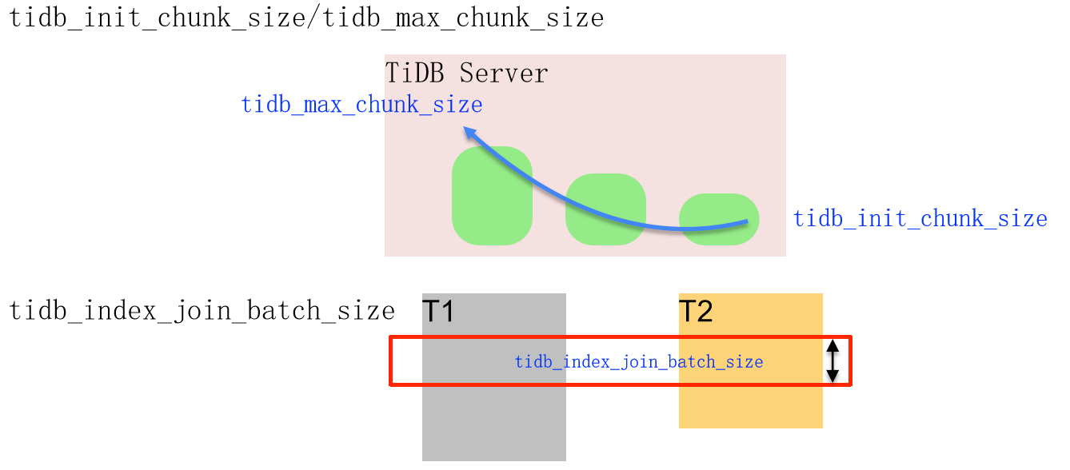
Batch Size
One Chunk contains multiple row data. SQL When the statement is executed, the executor starts with Chunk Perform JOIN operations such as getting data, evaluating expression, and so on. When the result set is large, the larger Chunk size Can improve performance if the result set is small, less than, Chunk size and the application is too large chunk of memory will cause a loss of performance.
Notes:
Batch size
- A chunk contains multiple row of data. When an SQL statement is executed, the executor performs data acquisition, expression evaluation, and JOIN operations in chunk units. When the result set is large, a larger chunk size can improve performance. If the result set is small, less than the chunk size, the memory of an oversized chunk will be requested. Causing a loss of performance
- tidb_init_chunk_size/tidb_max_chunk_size
- When an operator is executed, a chunk of tidb_init_chunk_size is created for the first time. When the result set is larger than the initial chunk size, the chunk size will be scale out the next time it is executed, and the size of the chunk size will be increased. If the result set still exceeds the chunk size, it will be expanded again. capacity until the upper limit set by tidb_max_chunk_size is reached
- tidb_index_join_batch_size
- Control the amount of data processed by the index join operator in a batch. Setting a larger size may improve performance at the cost of consuming more memory

Slide 19
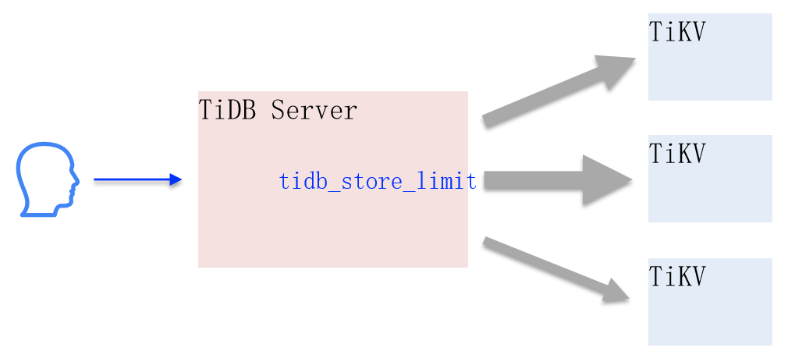
Limit
tidb_store_limit : Control the TiKV number of request sent to one node at the same time, avoiding a single TiKV The node caused a large number of requests to time out or return errors because the request volume was too large and exceeded its processing capacity.
tidb_retry_limit : Controls the number of retries for optimistic transactions. Optimistic transactions will be retried when they encounter transaction conflicts, but too many retries will exacerbate conflicts, resulting in performance degradation. Too few retries will reduce the success rate of transaction execution.
Notes:
Limit
- tidb_store_limit
- Control the number of request sent to one TiKV node at the same time to prevent a single TiKV node from timing out or return errors due to the large number of request exceeding its processing capacity
- tidb_retry_limit
- Control the number of retries of optimistic transactions. Optimistic transactions will be retried when they encounter transaction conflicts, but too many retries will exacerbate conflicts, resulting in performance degradation. Too few retries will reduce the success rate of transaction execution

Slide 20
Backoff
When a request encounters a retryable error, you need to wait for a period of time before retrying. Setting this time too large will increase the delay. If the setting is too small, it will cause many unnecessary retries and consume too much system resources.
tidb_backoff_weight : TiDB backoff The weight of the maximum time. Use this variable to adjust the maximum retry time.
tidb_backoff_lock_fast : The backoff time at which a read request encountered a lock.
Notes:
Backoff
- When a request encounters a retryable error, it is necessary to wait for a period of time before retrying. Setting this time too large will increase the delay. If the setting is too small, it will cause many unnecessary retries and consumes too much system resources
- tidb_backoff_weight
- The weight of the maximum time of TiDB backoff. Use this variable to adjust the maximum retry time
- tidb_backoff_lock_fast
- backoff time when the read request encountered the lock

Slide 21
Classroom Test
1) Prepared Plan Cache What are the following statements about correct?
  A. Avoiding the SQL overhead of TiDB repeated parse and generating execution plans
  B. Need to be called in conjunction with the upper application framework Prepare API
  C. For JDBC , it is recommended to configure in the connection parameter useServerPrepStmts = true
  D. StmtPrepare Use can be determined by Query Summary > QPS By Instance the request in the panel Prepare statement
Notes:
Answer: ABCD

Slide 22
Quiz
2) Regarding TiDB Backoff , what are the following statements wrong?
  A. Common Backoff type are pdRPC、regionMiss、serverBusy、tikvRPC、txnLock、txnLockFast、updateLeader
  B. Through TiDB Dashboard the following, KV Errors you can see the recent Backoff Type and retry time
  TiDB Slow log The corresponding slow requery Backoff Type and retry time are recorded in C.
  D. If the monitoring shows Backoff up, there may be a problem with the cluster
Notes:
Answer: D

Slide 23
Chapter Summary
Understand the system parameter you need to set when deploying a cluster
Understand the meaning of TiDB configuration parameter
Familiar with the functions and settings of common TiDB system variables
Notes:
- Understand the system parameter you need to set when deploying a cluster
- Familiar with the functions and settings of common TiDB system variables
- Understand the meaning of TiDB configuration parameter

Slide 24
Thanks

