Slide 1
Tidb Server For Diagnosing And Handling Database Oom Problems

Slide 2
Chapter Goals
Master TiDB Server OOM methods for judging phenomena
TiDB Server OOM Reason for diagnosis
Master mitigating TiDB Server OOM measures

Slide 3
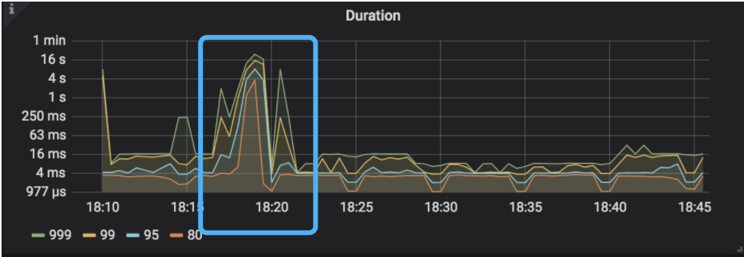
TiDB Server OOM Impact On Business
TiDB Server The business on SQL will fail
Increased business response times
Worse front-end experience

Slide 4
Diagnosis Method For Tidb Server OOM (A)
Client apps
logs
  dmesg -T | grep tidb-server In the results, there is a OOM-killer log of the time near the accident
  tidb.log ( "Welcome to TiDB" log of the time around after the accident < that is TiDB server A restart has occurred >)
  tidb_stderr.log ( grep to fatal error : "runtime: out of memory" or "cannot allocate memory" )
ERROR 2013 (HY000): Lost connection to MySQL server during query
Notes:
- tidb_stderr.log
- grep to fatal error: “runtime: out of memory” or “cannot allocate memory”.

Slide 5
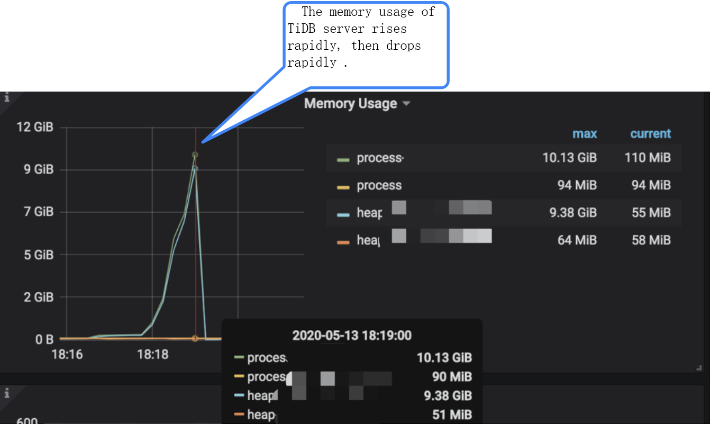
TiDB Server OOM Diagnostic Method (B)
Grafana monitor
  TiDB --> Server --> Memory Usage
Notes:
- Grafana monitoring
- TiDB —> Server —> Memory Usage, you can observe the TiDB server instance showing a rapid increase in memory and a rapid decline in memory
- TiDB —> Server —> Uptime, you can observe the startup time of the TiDB server instance, and use it with “Memory Usage” to confirm the operation status of the TiDB Server instance, such as whether the TiDB Server occurs at the same time as the memory usage is high restart phenomenon

Slide 6
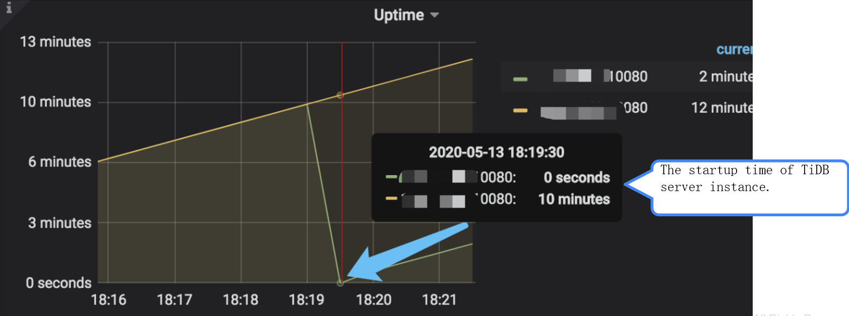
TiDB Server OOM Diagnostic Method (C)
Grafana monitor
TiDB --> Server --> Uptime , and use in 『Memory Usage』 conjunction with, confirm TiDB Server The health of the instance, and see if there is a spike in memory usage at the same time
Notes:
- Grafana monitoring
- TiDB —> Server —> Memory Usage, you can observe the TiDB server instance showing a rapid increase in memory and a rapid decline in memory
- TiDB —> Server —> Uptime, you can observe the startup time of the TiDB server instance, and use it with “Memory Usage” to confirm the operation status of the TiDB Server instance, such as whether the TiDB Server occurs at the same time as the memory usage is high restart phenomenon

Slide 7
TiDB Server OOM Causes
SQL Execution of statements
Golang Memory release mechanism

Slide 8
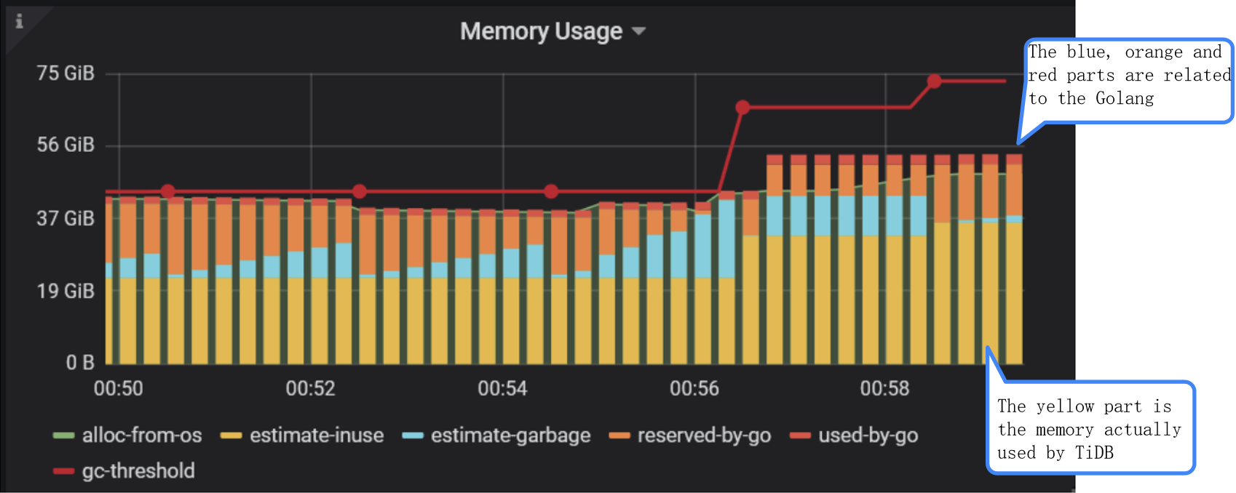
Grafana TiDB-Runtime Monitor
TiDB-Runtime --> Memroy Usage to confirm the TiDB Server OOM cause
Notes:
- The yellow part at the bottom is the memory that TiDB actually uses, and this is the only part that TiDB can control itself. For the rest of the usage, TiDB has no means to intervene. If the yellow part of the usage is not as expected, you can troubleshoot in the normal way, such as big query, heap profiles, etc.
Other than that, the high usage of any other part is the responsibility of Go, and TiDB itself is completely out of control. The reasons and possible solutions are described below.
- The blue part indicates the garbage part. This part is controlled by TiDB, even if the more memory is used, the more this part will be. Reduce the pressure of the recycler by enlarging the stack space
- The orange section, which is generally related to the highest memory usage in history, but is reuse when the heap grows, so it doesn't cause an OOM to be ignored.
- The red part (used-by-go), which also relates to the historical maximum heap size, but this part is not heap memory and will not be freed.

Slide 9
Positioning Memory That Takes Up A Lot Of SQL
TiDB Dashboard slow requery
TiDB Dashboard SQL Analysis of statement
TiDB Server In the log expensive query
Notes:
- slow requery on TiDB Dashboard
- TiDB Dashboard SQL statement analysis
- Perceived query in TiDB Server logs

Slide 10
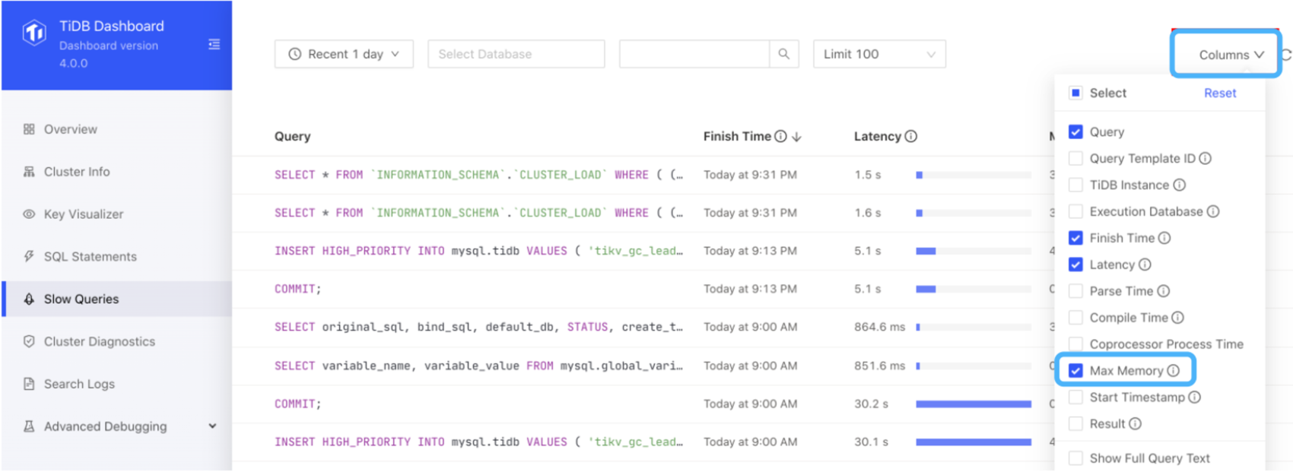
TiDB Dashboard Slow Requery
Adjust the time to the TiDB Server OOM previous and Max Memory sort by to find the ones in the cluster that consume the most memory SQL statement
Notes:
Adjust the time to before TiDB Server OOM and sort according to Max Memory. In this way, we can find the SQL list that consumes the amount of memory in the cluster.

Slide 11
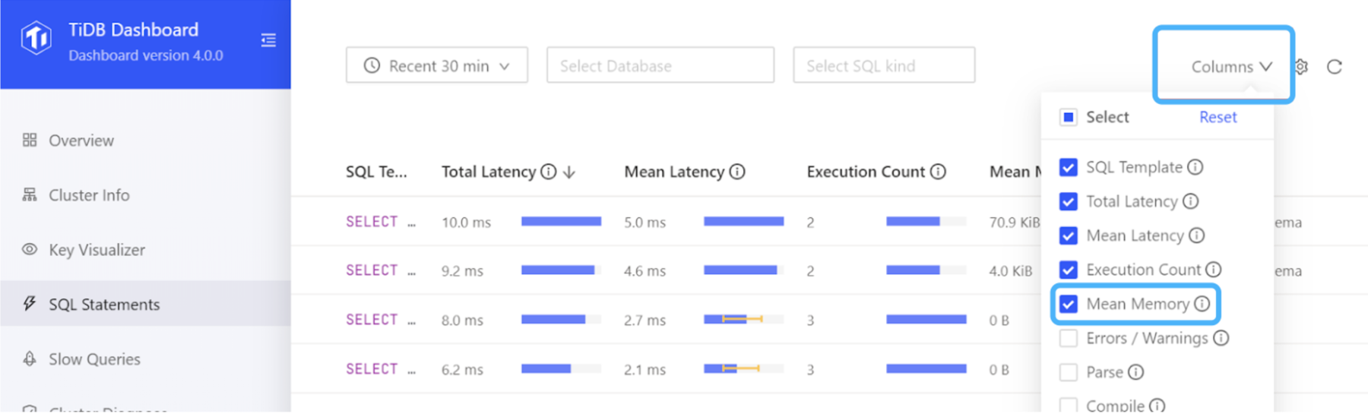
TiDB Dashboard SQL Analysis Of Statement
Adjust the time to the TiDB Server OOM previous and Max Memory sort by to find the ones in the cluster that consume the most memory SQL statement
Notes:
TiDB Dashboard SQL statement analysis

Slide 12
TiDB Server Logs - expensive query
When a statement reaches the resource usage threshold during execution (execution time < tidb_expensive_query_time_threshold >/amount of memory used< mem-quota-query >), TiDB Information about this statement will be written to the tidb-server log immediately
[2020/02/05 15:32:25.096 +08:00] [WARN] [expensivequery.go:167] [expensive_query] [cost_time=60.008338935s] [wait_time=0s] [request_count=1] [total_keys=70] [process_keys=65] [num_cop_tasks=1] [process_avg_time=0s] [process_p90_time=0s] [process_max_time=0s] [process_max_addr=10.0.1.9:20160] [wait_avg_time=0.002s] [wait_p90_time=0.002s] [wait_max_time=0.002s] [wait_max_addr=10.0.1.9:20160] [stats=t:pseudo] [conn_id=60026] [user=root] [database=test] [table_ids="[122]"] [txn_start_ts=414420273735139329] [mem_max="1035 Bytes (1.0107421875 KB)"] [sql="insert into t select sleep(1) from t"]

Slide 13
Mitigating TiDB Server OOM Measures
SQL Optimize to reduce the amount of data return unnecessarily
Reduce big transaction and split big ones into smaller transaction
Adjust the TiDB Server relevant parameter to limitation the SQL use of a single memory
Other TiDB Server OOM ways to mitigate
Notes:
Measures to mitigate TiDB Server OOM
- SQL optimization to reduce the amount of data return unnecessarily
- SQL business logic optimization to confirm whether the amount of data returned from the database to the client is reasonable
- SQL execution plan optimization to confirm the accuracy of the SQL execution plan, such as whether there is an unnecessary full table scan, and whether the table association is reasonable
- Reduce big transaction and split big ones into smaller transaction
- Adjust TiDB Server parameter, such as adjusting memory parameter that can be used by a single SQL, etc.
- Other ways to mitigate TiDB Server OOM, such as adjusting the GO memory release mechanism

Slide 14
SQL Optimization
SQL Business logic optimization
  TiDB Dashboard slow requery
  TiDB Dashboard SQL Analysis of statement
  TiDB Server In the log expensive query
Execution plan optimization
  The optimizer did not choose the optimal execution plan
  Necessary indexes were not created
  The execution plan is accurate, but the memory footprint is high
Notes:
You need to confirm with business development stakeholders whether it is reasonable to return large amounts of data and whether the scope of data can be narrowed down to meet business requirements.
- SQL execution plan optimization
We have already learned about TiDB SQL optimization through the previous SQL optimization course, so we will not go into it here, but only briefly explain it. If you have any questions, you can study the SQL optimization course again.
- Step 1: Through the TiDB Dashboard slow requery and SQL statement analysis function module, you can view the execution plan of SQL that occupies a large amount of memory in the cluster and the number of execution plans
- Step 2: Through step 1, it is basically possible to judge the accuracy of the execution plan
- The optimizer chose an inefficient execution plan
- The optimizer can be intervened in the following ways to select a low-cost, but highly accessible execution plan:
- Hint, SQL needs to be rewritten, which is intrusive to front-end services
- SPM, which interferes with the selection of execution plans without update SQL statement, automatic capture of bindings, automatic evolution bindings, etc.
- Checking the health of the statistics
- If the pesudo keyword appears in the SQL execution plan, it means that no statistics are available and the table or index needs to be analyzed
- If the statistics health is 100%, it is possible that the CBO optimizer cost estimate is inaccurate. You can use SQL Binding to fix the SQL execution plan without overwriting the SQL
- Necessary indexes were not created
- Create necessary indexes based on the behavioral characteristics of business access target tables to improve SQL access efficiency while reducing unnecessary data return and memory usage
- Accurate execution plan, but high memory usage
- If the statistics and optimizer selection are accurate, high memory usage may also occur. For example, the inner table of a hash join uses a lot of memory, so consider Merge Join.
- Merge Join is a special join algorithm. The Merge Join algorithm applies when the field to be joined by two related tables need to be read in a sorted order. Merge joins take up much less memory than hash joins, but merge joins cannot be executed concurrently and take longer to execute. It is recommended to try it when the amount of data is too large or the system is low on memory.

Slide 15
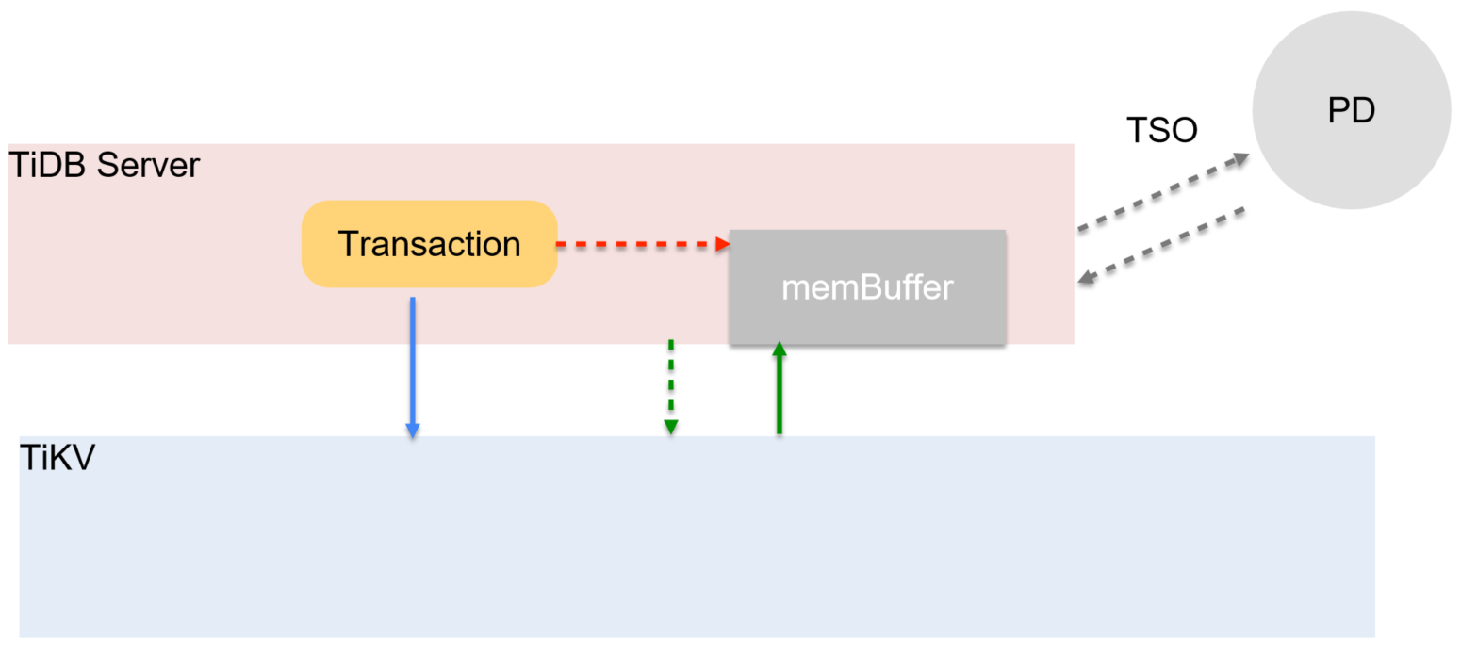
Split The Big Transaction
It is recommended to split large transactions into small transaction to increase the probability of successful transaction submission to a certain extent
Notes:
It is recommended to split large transactions into smaller transactions, to some extent, to improve the probability of successful transaction submission and reduce the cost of transaction rollback

Slide 16
TiDB Server Adjusting Parameter (A)
SQL Maximum Memory Used by a Single Bar & SQL Behavior After Exceeding Maximum Memory
  mem-quota-query
  oom-action
Notes:
Adjust TiDB Server parameter
The maximum memory consumed by a single SQL & the behavior of the SQL when the maximum memory is exceeded
- mem-quota-query
- Maximum memory threshold, in bytes, that a single SQL statement can consume. The default value is 1073741824
- request exceeding this value are handled by the behavior defined by oom-action, and the value is used as the initial value of the system variable tidb_mem_quota_query
- oom-action
- Behavior when the memory usage of a single SQL in TiDB exceeds the mem-quota-query limitation and the temporary disk cannot be reused
- Default value: “cancel”. When set to “log”, only logs are output. When set to “cancel”, cancels the execution of the SQL operation and outputs the log.

Slide 17
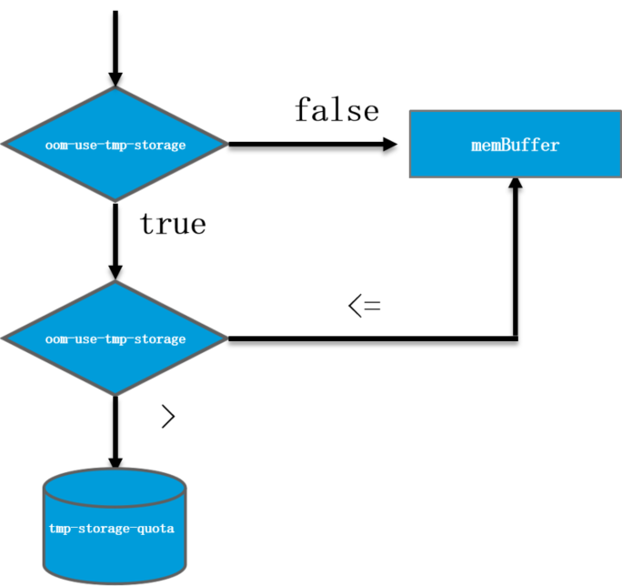
Adjustment TiDB Server Parameter (B)
Enable ephemeral disks
  oom-use-tmp-storage
  tmp-storage-path
  tmp-storage-quota
Notes:
- oom-use-tmp-storage
- Set whether to enable ephemeral disks for certain operators when memory usage for a single SQL statement exceeds the mem-quota-query limitation. Default is true
- tmp-storage-path
- Temporary disk storage location for some operators when the memory usage of a single SQL statement exceeds the mem-quota-query limitation.
- The default value is: <操作系统临时文件夹><操作系统用户ID> <host><port><statusHost><statusPort>/tmp-storage for the base64 encoded result of /_tidb/:/:.
- tmp-storage-quota
- The limit for tmp-storage-path storage usage, in bytes. When a single SQL statement uses temporary disks, causing the total number of temporary disks of the TiDB Server to exceed tmp-storage-quota, the current SQL operation is canceled and Out Of Global Storage Quota! Wrong.
- When tmp-storage-quota is less than 0, there are no Checking and limitation listed above.

Slide 18
Other Method To Reduce Memory Usage
Adjusting the GO memory release strategy
  GO Runtime When freeing memory and return to the kernel, Linux There are two strategies under the platform:
    MADV_DONTNEED
    MADV_FREE
  TiDB Server Add GODEBUG=madvdontneed=1 environment variable before starting
restart rolling basis TiDB Server
Notes:
Other method to reduce memory usage
Use the TIDB-Runtime —> Memroy Usage panel in Grafana to confirm that if it is a memory usage exception caused by non-SQL, that is, a non-yellow part occupation exception, you can try the following method:
- Adjusted GO memory release strategy
GO's runtime has two strategies for freeing memory to return to the kernel under the Linux platform:
- MADV_DONTNEED: Will decrease the number of RSS very quickly, but it is less efficient
- MADV_FREE: Runtime uses the more efficient MADV_FREE when freeing memory, i.e. the kernel waits until memory is tight to release. This memory can still be reused until it is freed. This feature is supported starting with the Linux 4.5 kernel
Add the environment variable GODEBUG=MADVDONTNED=1 before starting the TIDB Server, and return the memory to the operating system immediately upon GC, reducing memory usage.
- restart TiDB Server on a rolling basis

Slide 19
Quiz
1) Which of the following factors can cause TiDB Server abnormal memory usage? (Please select 3)
  A. Large transaction cause memory enlargement
  B. A large amount of non-essential data SQL return to TiDB due to misalignment of the execution plan
  C. GO 's memory reclamation mechanism may also lead to abnormal memory usage
  D. ADD Index operation, write reorg also takes up a lot of memory during the stage
Notes:
Answers: a, b, c

Slide 20
Quiz
2) TiDB Server In, what parameter can I adjust to limitation SQL the memory usage of a single bar? (Please select 2 items)
  A. mem-quota-query to set the SQL maximum memory threshold that can be consumed by a single statement
  B. oom-use-tmp-storage Turn on ephemeral disk
  C. rocksdb.defaultcf.block-cache-size RocksDB defaultcf Adjusted memory usage
  D. rocksdb.writecf.block-cache-size RocksDB writecf Adjusted memory usage
Notes:
Answer: a, b

Slide 21
Chapter Summary
Master the TiDB Server OOM method of judging phenomena
TiDB Server OOM Reason for diagnosis
Master mitigating TiDB Server OOM measures

Slide 22
Thanks

